Slide 1
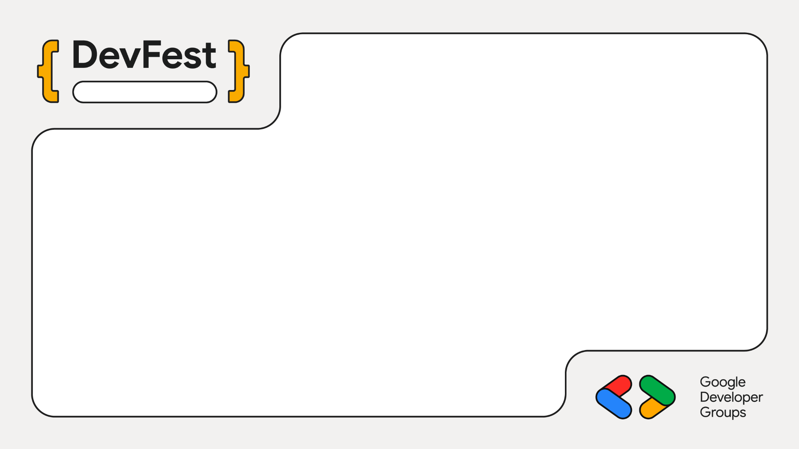
Nagpur
Making Databases Conversational with Gemma
Mayur Madnani

Slide 2
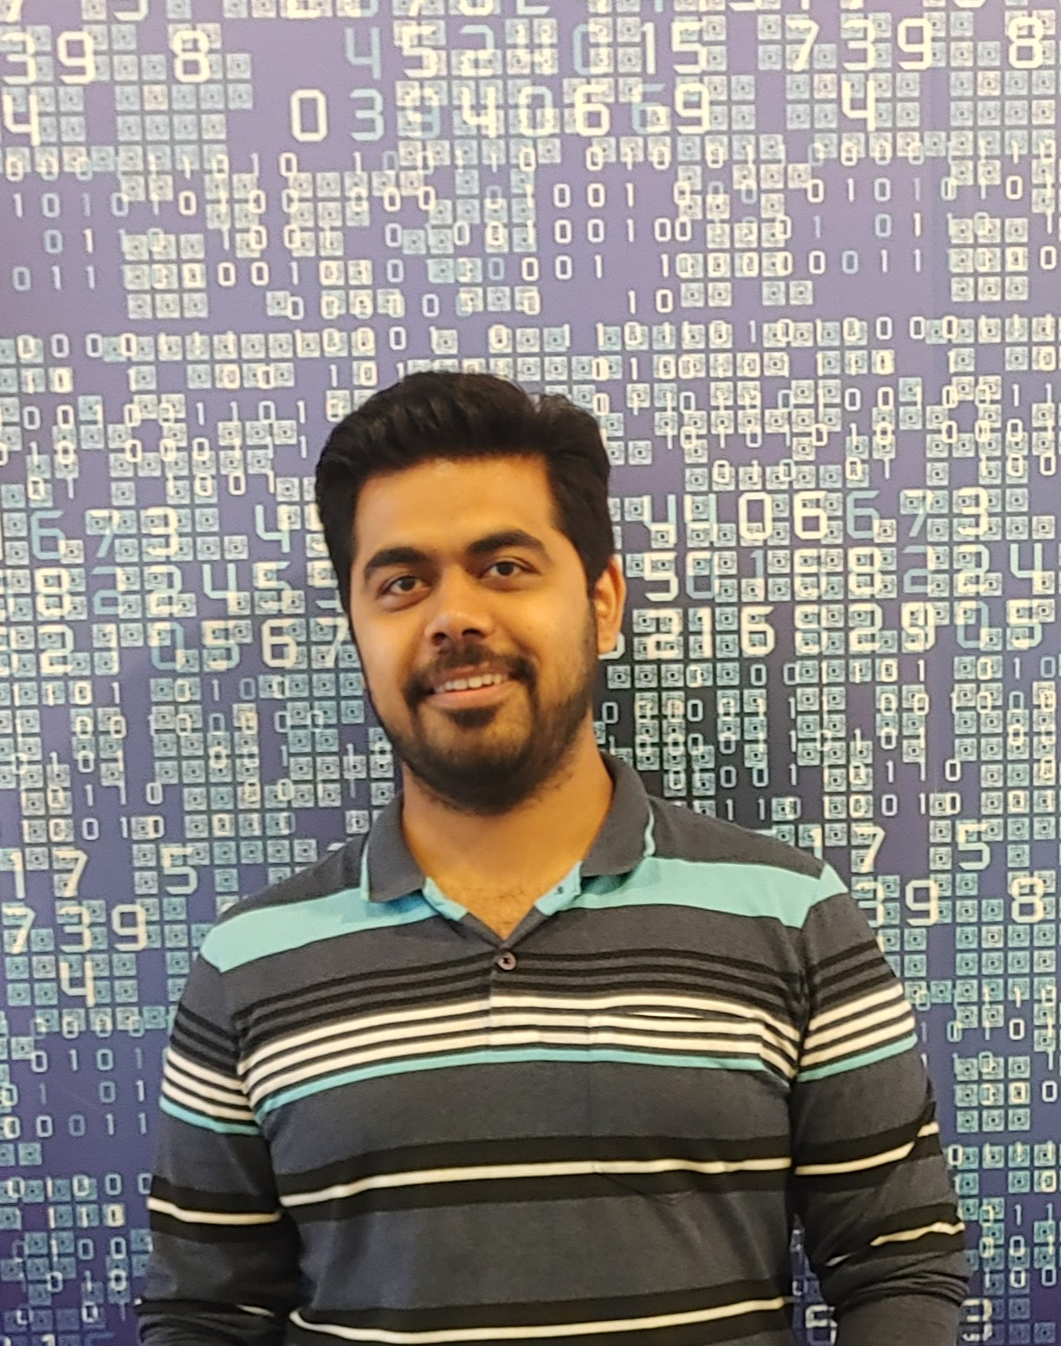
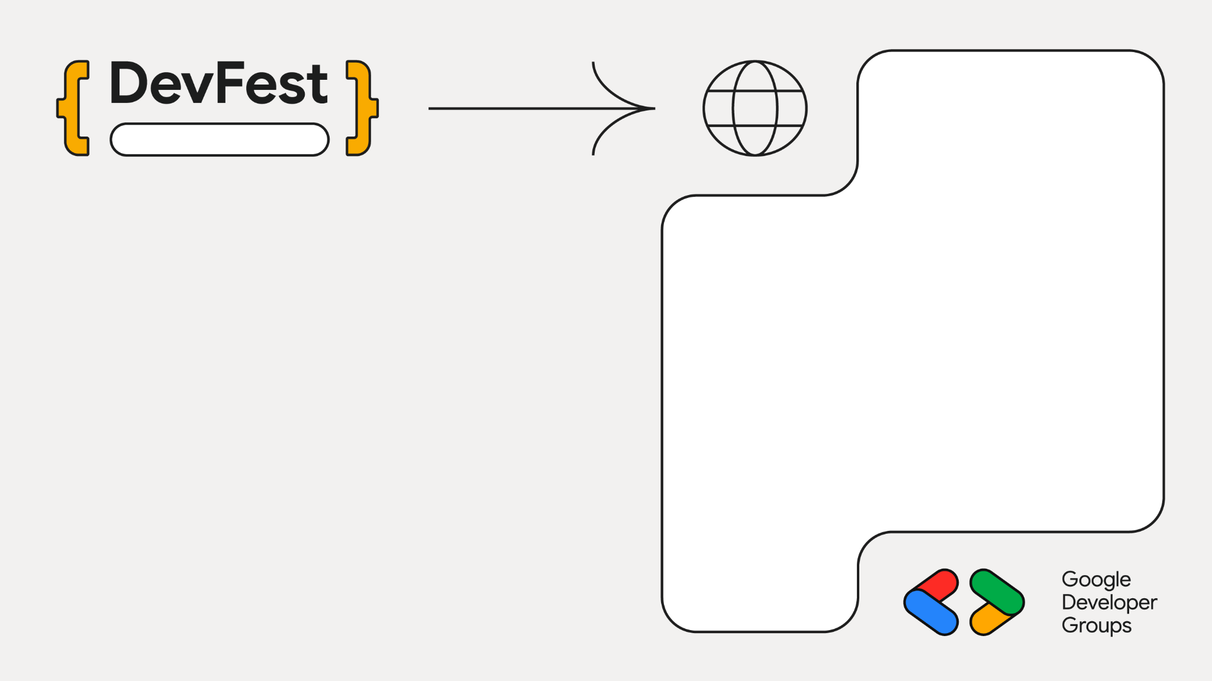
Nagpur
Staff Engg @ JioHotstar
Previously @ Intuit, Walmart, SAP
Expertise in Data, AI and Backend
~10 years in the Industry
GenAI Course Author
Mentor & Speaker
Mayur Madnani

Slide 3
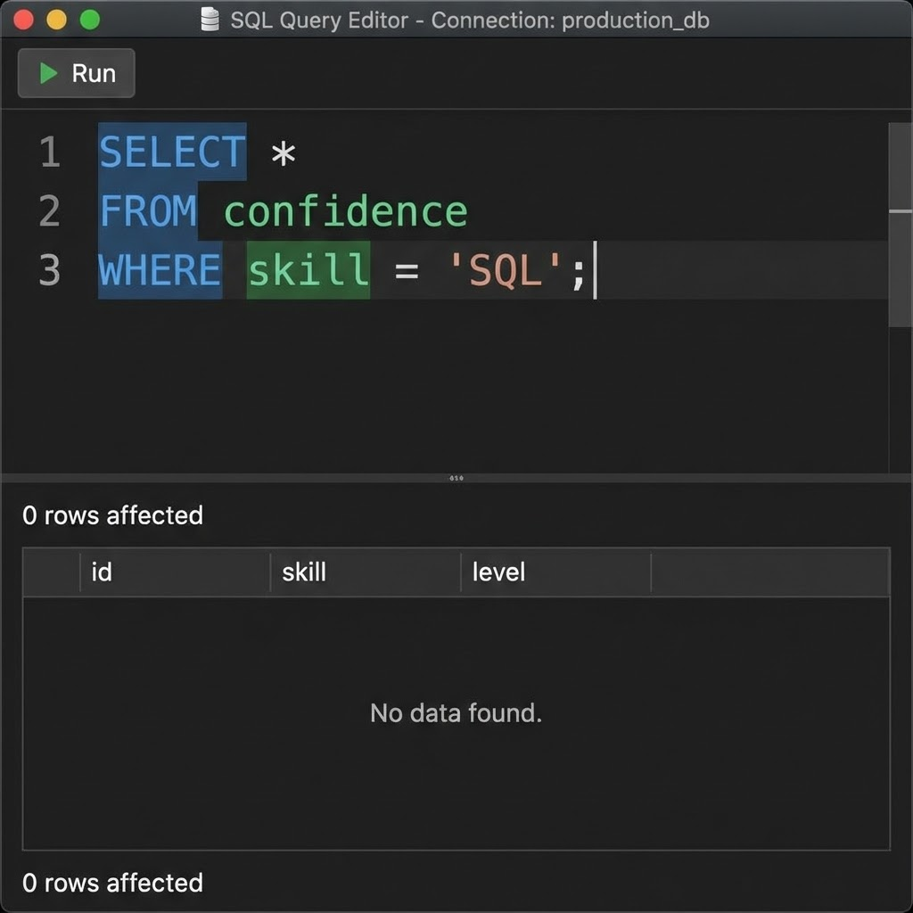

SELECT * FROM users ... but HOW do I filter by multiple conditions?
Is it WHERE or HAVING?
Did I close the parentheses?
Why is this query taking 5 minutes to run?
The SQL Complexity
Everyone's been here.
None of us enjoy this

Slide 4
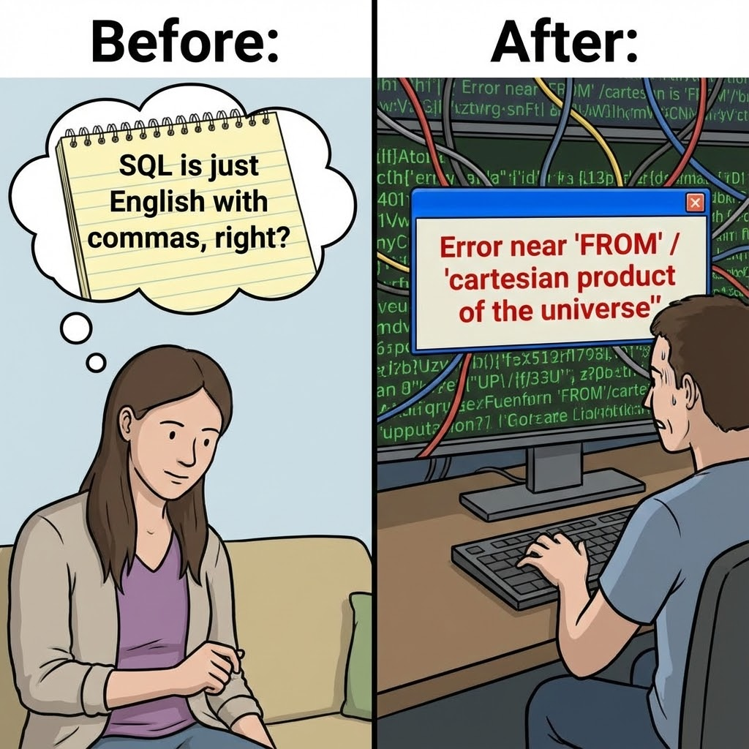
Non-SQL users blocked on data access
Developers spend 20-30% time writing/explaining queries
Only 25% of team can write production SQL
Knowledge bottleneck kills velocity
SQL is plain English?

Slide 5
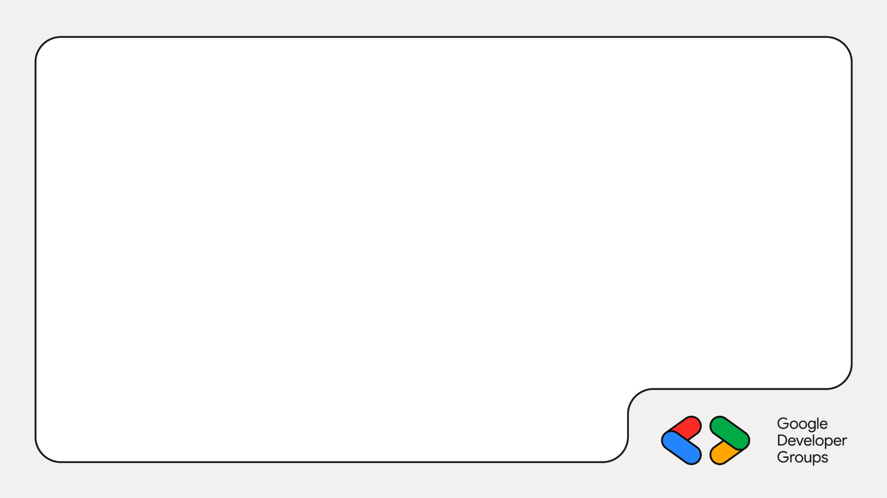
Enter: SQLSense
Specialized agent for one job, done exceptionally well — translate between human intent and SQL.
Input
Question or SQL snippet
Model Processing
Gemma on Cloud Run intelligently parses and structures
Output
English query -> SQL and SQL -> Explanations

Slide 6
Let us look at some code now
And create our
SQL Agent

Slide 7
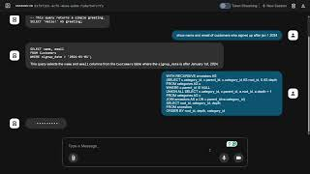
Demo

Slide 8
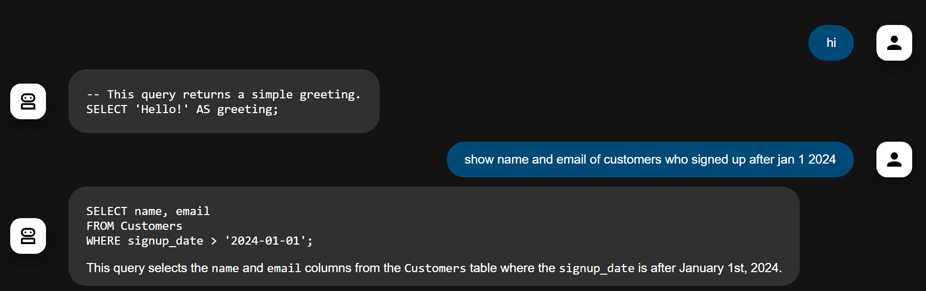
Demo

Slide 9
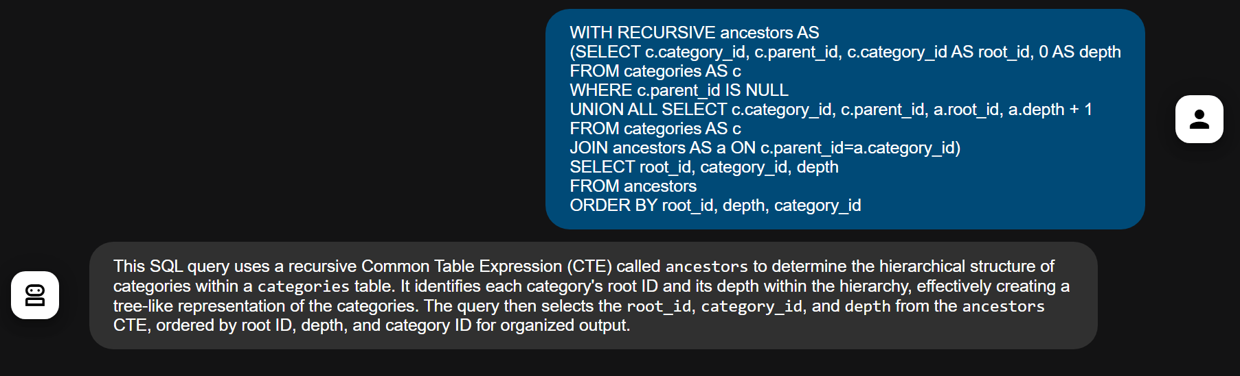
Demo

Slide 10
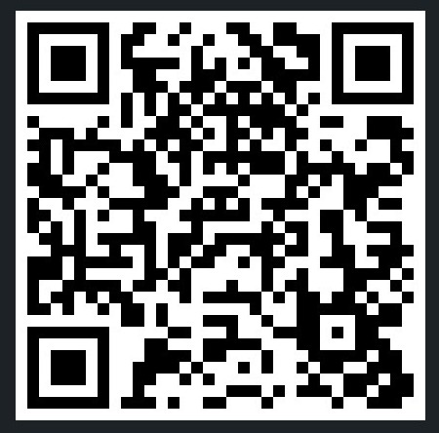
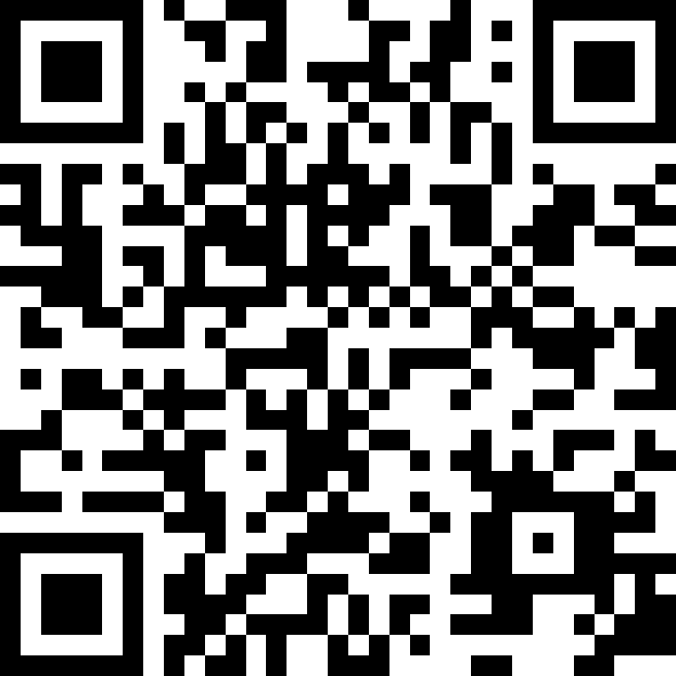
🌐linkedin.com/in/mayurmadnani
🌐github.com/mayurmadnani/workshop-gcp-intent-to-agents

